Slide 1
Software Project Lab(SPL) 01
Topic : Memory mapping of a java program.
Supervisor : Nadia Nahar

Slide 2
Objectives
Finding out the variables (especially primitive types)
Estimating the amount of memory consumed by those variables while running this code
Presenting them by a graph

Slide 3
Advantage
Getting a visualization of memory consumption by the variables
Can get a better idea about the chances of segmentation fault

Slide 4
What I have done so far!
Code:
Static Analysis of a java/c program to find out the variables and total memory consumption
Github Repository Link:
https://github.com/antanvir/spl

Slide 5
What I have done so far!
Studies:
Memory allocation of C variables
Memory allocation of Java Objects

Slide 6
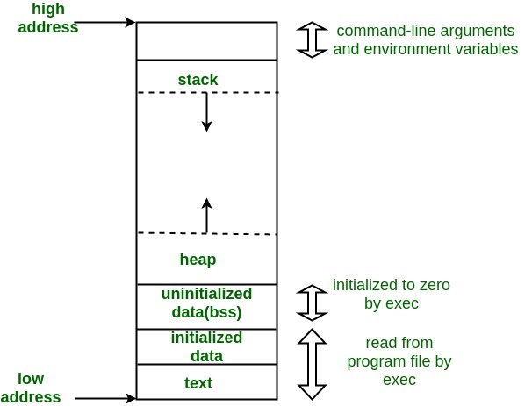
Fig: Memory allocation of C variables*

Slide 7
What to do next…
Dynamic analysis of variables using aspect
Making a graph for the variables

Slide 8
Thanks ☺

